Slide 1
Band Performance Basics

Slide 2
Matching
What to Listen for and Adjust to
Musicians listen to each other and match the following:
Tone Quality – Imitate the best tone in the section.
Pitch – Sound like one. Play in tune.
Dynamics – Blend with others. Don’t stick out.

Slide 3
Releases
How to perform a good release.
Band members should release in the following order:
High instruments release first.
Middle instruments release second.
Tubas release last.

Slide 4
Playing Position
How to hold band instruments.
Band instruments should be held as follows:
Hold flutes parallel to the floor.
Hold clarinets at a 45 degree angle.
Concert band trumpets are pointed at the stand.
Jazz Band trumpets are pointed above the stand.
Trombones are always pointed above the stand.

Slide 5
8th Notes Tied Across a Bar Line
8th notes tied across a bar line should be played
SHORT.

Slide 6
Long Notes Tied to Short Notes
To play a long note tied to a short note precisely,
REST ON THE SHORT NOTE.

Slide 7
Classical Grace Notes
Classical grace notes are played as illustrated:
FULL VALUE AND ON THE BEAT.

Slide 8
20TH Century Grace Notes
20th century grace notes are played as illustrated:
JUST BEFORE THE BEAT.

Slide 9
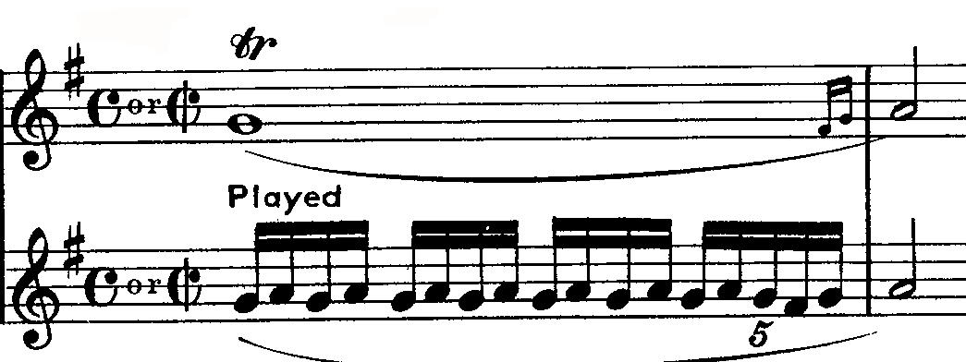
Trills

