Slide 1
Book One Review

Slide 2
Dynamics
The control of volume – How loud or soft to play
Fortissimo ( ff ) very loud
Forte ( f ) loud
Mezzo forte ( mf ) medium loud
Mezzo piano ( mp ) medium soft
Piano ( p ) soft
Pianissimo ( pp ) very soft

Slide 3
“Road Signs”
Words and symbols that tell you where to play next or when to stop.
Da Capo (D.C.) – repeat from the beginning
Dal Segno (D.S.) – repeat from the sign
Fine – finish or end
- Segno (the sign)

Slide 4
Lines and spaces
FACE – Spaces of the treble clef
Spell the word FACE
EGBDF – Lines of the treble clef
Every Good Boy Does Fine
ACEG – Spaces of the bass clef
All Cows Eat Grass
GBDFA – Lines of the bass clef
Good Boys Do Fine Always

Slide 5
Tempo words
Presto – very fast
Allegro – fast
Moderato – moderately fast
Andante –moderate walking tempo
Largo – slow
Ritardando (rit.) – gradually slower

Slide 6
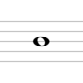
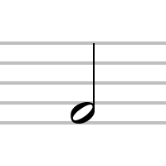
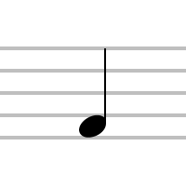
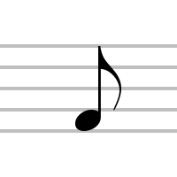
Notes
Whole note (four beats)
Half note (two beats)
Dotted half note (three beats)
Quarter note (one beat)
Eighth note (½ beat)

Slide 7
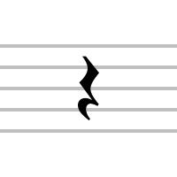
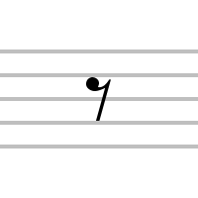
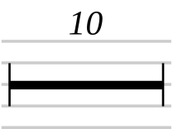
rests
Whole rest (four beats)
Half rest (two beats)
Quarter rest (one beat)
Eighth rest (½ beat)
Multiple-measure rest

Slide 8
Words
Proceeding by half steps
Chromatic
Measure
Distance between bar lines
Divisi (div.)
Divide parts
Arpeggio
Broken chord

Slide 9
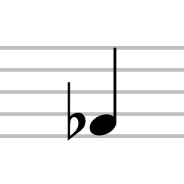
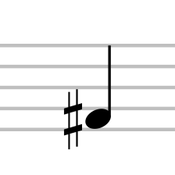
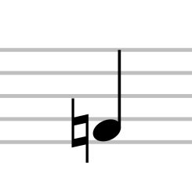
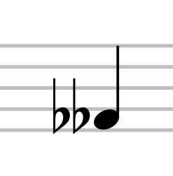
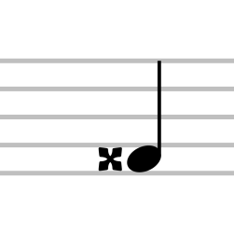
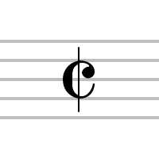
Signs and symbols
Flat – Lowers note ½ step
Sharp – Raises note ½ step
Natural – Cancels previous accidentals
Double flat – Lowers note two ½ steps
Double sharp – Raises note two ½ steps
Segno – The sign
Alla breve – Cut time

Slide 10
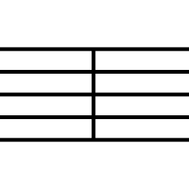
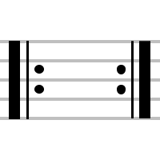
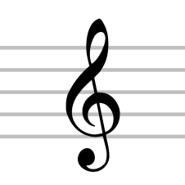
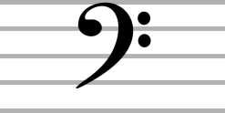
Signs and symbols
Staff
Bar line – Separates the staff into measures
Ledger lines – Extends the staff up and down
Double bar – Final stop sign
Repeat sign – Repeat between the signs
Treble clef sign
Bass clef sign

Slide 11
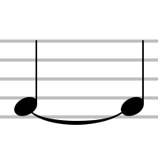
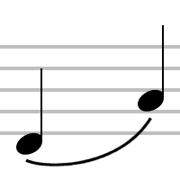
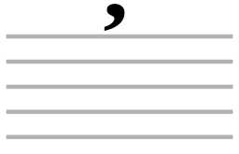
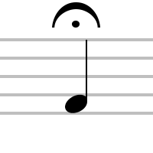
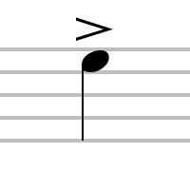
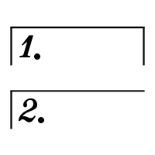
Signs and symbols
Tie – Connects two notes of the same pitch
Slur – Tongue 1st note, blow & finger 2nd note
Breath mark
Fermata – Hold note longer
Accent mark – Heavy, with emphasis, bell-like
Coda sign
First and second endings

