Slide 1
Major Key Signatures

Slide 2
Order of Sharps and Flats
Order of the Sharps:
Father Charles Goes Down And Eats Breakfast
♯ ♯ ♯ ♯ ♯ ♯ ♯
F C G D A E B
Order of the Flats:
The reverse of the Sharps
♭ ♭ ♭ ♭ ♭ ♭ ♭
B E A D G C F

Slide 3
Flat Rule
The name of the key is the next-to-the-last flat.
♭ ♭ ♭ ♭ ♭ ♭ ♭
Flat order:
B E A D G C F
Example : The key with four flats is A♭ because A♭ is the third flat.

Slide 4
Sharp Rule
The name of the key is one half step higher than the last sharp.
Sharp order:
♯ ♯ ♯ ♯ ♯ ♯ ♯
F C G D A E B
C♯ D♯ F♯ G♯ A♯ C♯
Higher
The key of A has three sharps because
A is one half step higher than G♯.

Slide 5
Major Key “Crutch”
Sharps
7 6 5 4 3 2 1 0
♯ ♯
C F
C F
B E A D
G C
G C
♭ ♭ ♭ ♭ ♭ ♭
B E A D
0 1 2 3 4 5 6 7
Flats

Slide 6
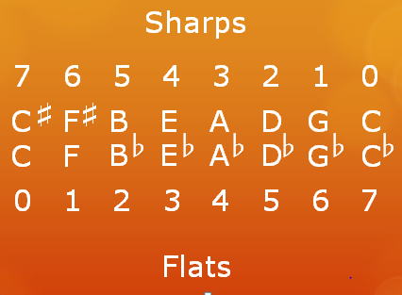
The Crutch (circle) Teaches . . .
All the major key signatures: F major has one flat, F♯ major has six sharps, A major has three sharps, and so forth.
The number of sharps plus flats of same letter keys always equals 7. Example: B♭ (2 flats) + B (5 sharps) = 7
C = no sharps or flats. C♯ = 7 sharps. C♭ = 7 flats.
F♯ & G♭(same note) both have 6 (sharps & flats).

