Slide 1
Minor Key Signatures

Slide 2
Major Minor Relations
Major and minor keys that begin on the
same note are called Parallel.
Example: C Major and C minor
both start on C.
Major and minors keys that have the
same key signature are called Relative.
Example: C major and A minor both
have no sharps or flats.

Slide 3
Finding Minor Keys
The parallel minor key signature can be
found by adding three flats to the major key.
Example:
F major has 1 flat
+3 flats
F minor has 4 flats

Slide 4
Flats vs. Sharps
When added together, sharps and flats
cancel each other out, similar to positive
and negative numbers.
Example:
D major has 2 sharps
2
-3
-1
+3 flats
D minor has 1 flat

Slide 5
Key Signature Limit
A key signature cannot have more than seven flats or sharps.
Example:
6 flats + 3 flats = 9 flats
When needed, use the enharmonic name of the note.
Example:
Instead of using G♭(6+3=9),
use F♯ (6♯ + 3♭ = 3♯).

Slide 6
Minor Key “Crutch”
All Dogs Get Caught For Biting Elementary Administrators
Sharps
7 6 5 4 3 2 1 0
♯ ♯ ♯ ♯ ♯
A D G C F B E A
♭ ♭ ♭
A D G C F B E A
0 1 2 3 4 5 6 7
Flats

Slide 7
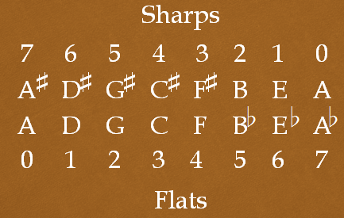
The Crutch (circle) Teaches . . .
All the minor key signatures: B minor has two sharps, B♭ minor has five flats, C minor has three flats, and so forth.
The number of sharps plus flats of the same letter keys always equals 7. Example: F (4 flats) + F♯ (3 sharps) = 7
A = no sharps or flats. A♯ = 7 sharps. A ♭= 7 flats
E♭ & D♯ (same note) both have 6 (flats and sharps).

