Slide 1
Music Theory

Slide 2
Thirds
The interval between two notes on consecutive lines or spaces is called a third.
The most commonly used thirds are . . .
Minor thirds (m3) which have three half steps.
Major thirds (M3) which have four half steps.
Thirds are the building blocks of western harmony.

Slide 3
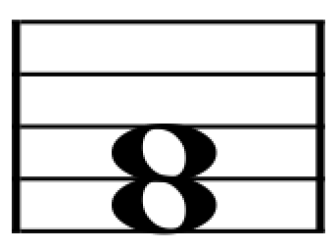
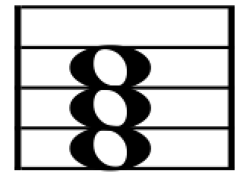
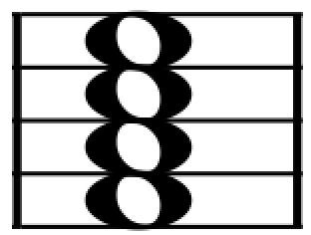
Chord Construction
Two notes on consecutive lines or spaces form a third.
Example:
Two thirds together form a triad.
Example:
Three thirds together form a 7th chord.
Example:
Example:
Example:

Slide 4
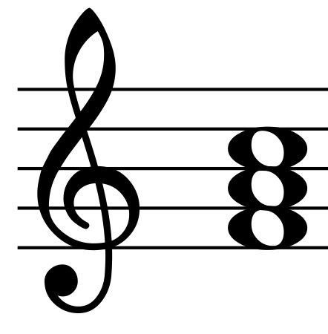
Chord Quality
The arrangement of major and minor thirds within a chord determines its quality.
A major third below a minor third forms a major triad.
three half steps = minor 3rd
four half steps = major 3rd
Major triad
Example:
Example:

Slide 5
Triads
In the diagram below, small boxes represent minor thirds and large boxes represent major thirds.
♯
G
G
G
♭
G
E
E
♭
♭
E
E
C
C
C
C
Major
(M)
Minor
(m)
Diminished
(dim)
Augmented
(Aug)
Example:
Example:

Slide 6
7TH Chords
B
♭
♭
♭
B
B
B
♭
B
♭
G
G
G
♭
♭
G
G
E
E
♭
♭
♭
E
E
E
C
C
C
C
C
MM7
Mm7
mm7
½dim7
dim7
Example:
Example:

