Slide 1
Rhythm

Slide 2
The Basic Musicianship Skills
Tone
Intonation
Technique
Rhythm
Interpretation

Slide 3
Rhythm
Rhythm has two types of meter:
Duple
Triple

Slide 4
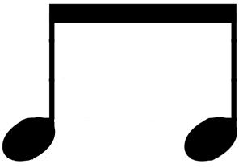
Duple Meter
A quarter note usually gets one beat in duple meter.
Each beat in duple meter is divided into two equal parts.
Example:
=

Slide 5
Duple Meter Time Signatures
The bottom number of a duple meter time signature is usually a four.
Examples:
2
4
3
4
4
4

Slide 6
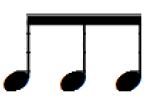
Triple Meter
A dotted-quarter note usually gets one beat in triple meter.
Each beat in triple meter is divided into three equal parts.
Example:
=

Slide 7
Triple Meter Time Signatures
The bottom number of a triple meter time signature is usually an eight.
Examples:
3
8
6
8
9
8

Slide 8
Important Decision
The most important rhythmic decision to make before playing a piece of music is . . .
Which meter is it in?
Duple or Triple

Slide 9
Spelling
The word “rhythm” is spelled . . .
R
H
Y
T
H
M

