Slide 1
Rhythm Diagrams

Slide 2
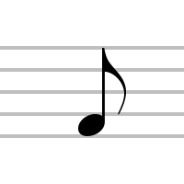
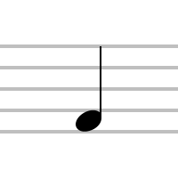
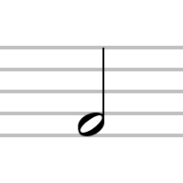
Duple Meter Rhythms
Rules:
Draw one line per note.
Draw one V per beat.
Examples:

Slide 3
Duple Meter Quiz
Diagram the following rhythm patterns:
1.
2.
3.
4.
5.
6.
7.
8.
9.
10.

Slide 4
Triple Meter Rhythms
Rules:
Draw one line per note.
Draw one check per beat.
Examples:

Slide 5
Triple Meter Quiz
Diagram the following rhythm patterns:
1.
2.
3.
4.
5.
6.
7.
8.
9.
10.

